Slide 1
Eugenics
A History

Slide 2
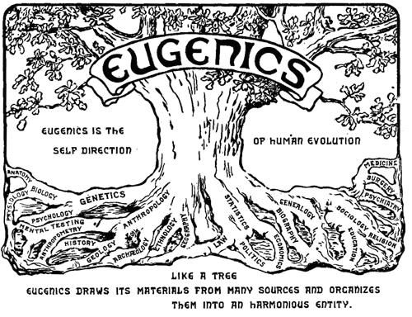

Slide 3


Slide 4
What does it mean?
Literally translated: “Good Genes” or “Well Born.”

Slide 5
What does it mean?
Literally translated: “Good Genes” or “Well Born.”
“EUGENICS is the science which deals with all influences that improve the inborn qualities of a race; also with those that develop them to the utmost advantage.” – Francis Galton

Slide 6
What does it mean?
Literally translated: “Good Genes” or “Well Born.”
“EUGENICS is the science which deals with all influences that improve the inborn qualities of a race; also with those that develop them to the utmost advantage.” – Francis Galton
Based on the idea that “degeneracy” and immoral behavior is inheritable, and thus can be bred out of a population.

Slide 7
How did it begin?

Slide 8
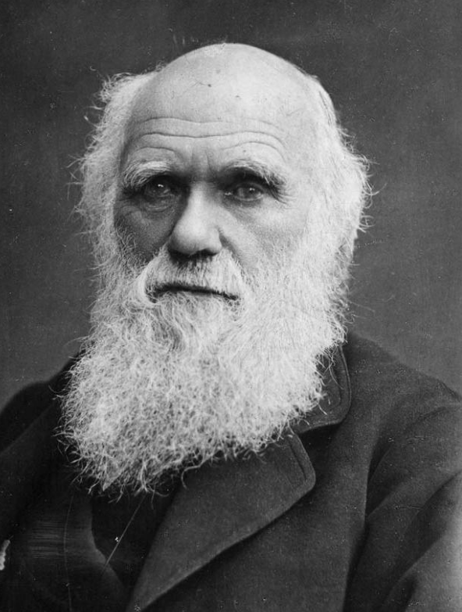
This guy.

Slide 9
On the Origin of Species by Means of Natural Selection, or the Preservation of Favoured Races in the Struggle for Life - 1859

Slide 10
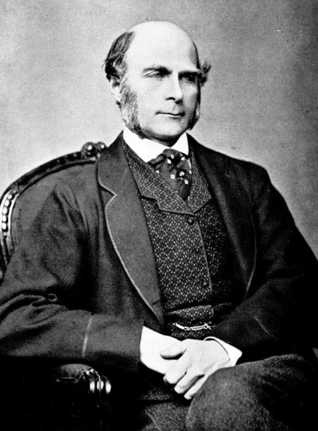
Actually, it was his cousin: This guy.
Notes:
Published Hereditary Genius in 1869 in which he studied eminence and found that the closer someone was related to an eminent man, the more likely he, too was eminent.

Slide 11

Okay, technically it was probably this guy:

Slide 12
Methods of Eugenic selection:
Anti-miscegenation laws
Segregation
Strict Immigration policies
Forced Abortion
Forced Sterilization

Slide 13
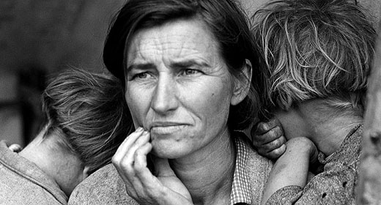
Main targets of Eugenics:
The Poor

Slide 14

Main targets of Eugenics:
The Poor
The Blind

Slide 15

Main targets of Eugenics:
The Poor
The Blind
The Deaf

Slide 16
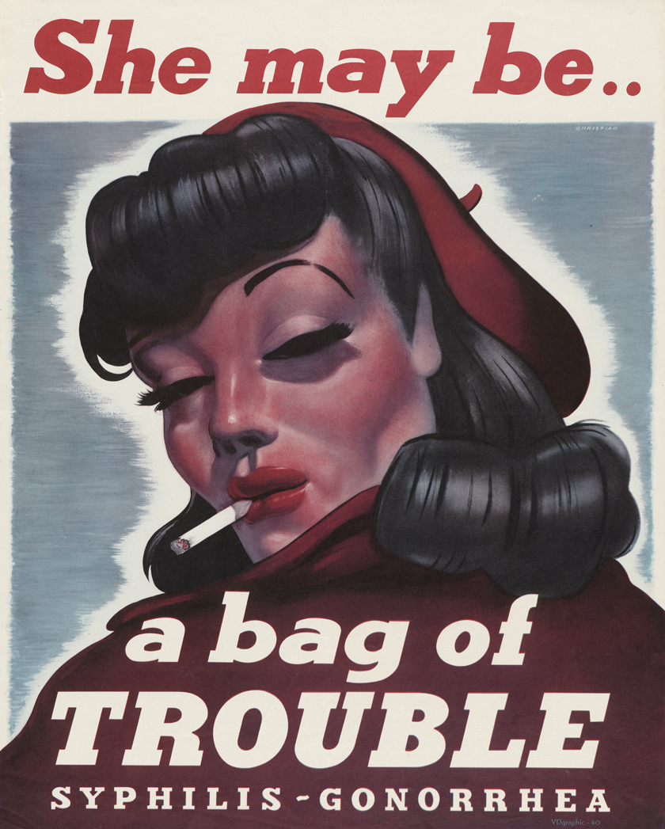
Main targets of Eugenics:
The Poor
The Blind
The Deaf
Promiscuous Women

Slide 17
Main targets of Eugenics:
The Poor
The Blind
The Deaf
Promiscuous Women
Developmentally Disabled
Mentally Ill and Disabled

Slide 18

Popularity!

Slide 19
The Immigration Act of 1924 used eugenic language, and was passed “to preserve the ideal of American homogeny.”

Slide 20
The Immigration Act of 1924 used eugenic language, and was passed “to preserve the ideal of American homogeny.”
In 1927, the SCOTUS upheld as constitutional the compulsory sterilization of Carrie Buck of Virginia. This ruling has not been overturned. Va. didn’t repeal its sterilization law until 1974.

Slide 21
The Immigration Act of 1924 used eugenic language, and was passed “to preserve the ideal of American homogeny.”
In 1927, the SCOTUS upheld as constitutional the compulsory sterilization of Carrie Buck of Virginia. This ruling has not been overturned. Va. didn’t repeal its sterilization law until 1974.
By 1928 there were 376 University programs with Eugenics curricula.

Slide 22
The Immigration Act of 1924 used eugenic language, and was passed “to preserve the ideal of American homogeny.”
In 1927, the SCOTUS upheld as constitutional the compulsory sterilization of Carrie Buck of Virginia. This ruling has not been overturned. Va. didn’t repeal its sterilization law until 1974.
By 1928 there were 376 University programs with Eugenics curricula.
By the mid 1930s 40 states had laws restricting the marriage of the “feebleminded” and insane.

Slide 23

It was all about race…

Slide 24
…except when it wasn’t
Eugenics policies were not aimed at directly getting rid of racial minorities.

Slide 25
…except it totally was
Eugenics policies were not aimed at directly getting rid of racial minorities.
Several African American intellectuals of the time were supporters of Eugenics.

Slide 26
…super racist
Eugenics policies were not aimed at directly getting rid of racial minorities.
Several African American intellectuals of the time were supporters of Eugenics.
W. E. B. DuBois (the first African American to earn a Doctorate from Harvard) believed that “only fit blacks should procreate to eradicate the race’s heritage of moral iniquity.”

Slide 27
…yeah.
Eugenics policies were not aimed at directly getting rid of racial minorities.
Several African American intellectuals of the time were supporters of Eugenics.
W. E. B. DuBois (the first African American to earn a Doctorate from Harvard) believed that “only fit blacks should procreate to eradicate the race’s heritage of moral iniquity.”
The NAACP promoted eugenics by holding “Better Baby” contests.

Slide 28
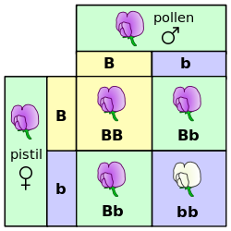

Slide 29

Notes:
This was nearly 150 years ago…

Slide 30
Eugenics shifts after WWII
Eugenics becomes increasingly associated with Nazi Germany and the Holocaust.

Slide 31
Eugenics shifts after WWII
Eugenics becomes increasingly associated with Nazi Germany and the Holocaust.
Doctors in the Nuremberg trials defend themselves by claiming the American Eugenics programs were their inspiration and that prosecuting them was hypocritical.

Slide 32
Eugenics shifts after WWII
Eugenics becomes increasingly associated with Nazi Germany and the Holocaust.
Doctors in the Nuremberg trials defend themselves by claiming the American Eugenics programs were their inspiration and that prosecuting them was hypocritical.
In response to public opinion shifting, the Eugenics movement becomes fused with the Birth Control movement and becomes “Population Control.”

Slide 33
Eugenics shifts after WWII
In 1965 a study revealed that nearly 35% of women in Puerto Rico had been sterilized as part of a federal program.

Slide 34
Eugenics shifts after WWII
In 1965 a study revealed that nearly 35% of women in Puerto Rico had been sterilized as part of a federal program.
Title X, officially known as The Family Planning Act, was signed into law by Richard Nixon in 1970 and allowed the use of federal funds for sterilization.

Slide 35
Eugenics shifts after WWII
In 1965 a study revealed that nearly 35% of women in Puerto Rico had been sterilized as part of a federal program.
Title X, officially known as The Family Planning Act, was signed into law by Richard Nixon in 1970 and allowed the use of federal funds for sterilization.
Sweden ends it’s National Eugenics program in 1975.

Slide 36
Eugenics today:
Pre-natal genetic testing allows for early screening of genetic disorders and future risk factors of disease (e.g. BRCA1 and 2).

Slide 37
Eugenics today:
Pre-natal genetic testing allows for early screening of genetic disorders and future risk factors of disease (e.g. BRCA1 and 2).
In Europe, 92% of Down’s Syndrome diagnoses are terminated. In the US the rate is around 68%.

Slide 38
Eugenics today:
Pre-natal genetic testing allows for early screening of genetic disorders and future risk factors of disease (e.g. BRCA1 and 2).
In Europe, 92% of Down’s Syndrome diagnoses are terminated. In the US the rate is around 68%.
California Governor Jerry Brown signed into law a bill that outlawed using sterilization as a method of birth control in California Prisons. This law went into effect January 1, 2015.

Slide 39

Psychiatry!

Slide 40


Slide 41


